Slide 1
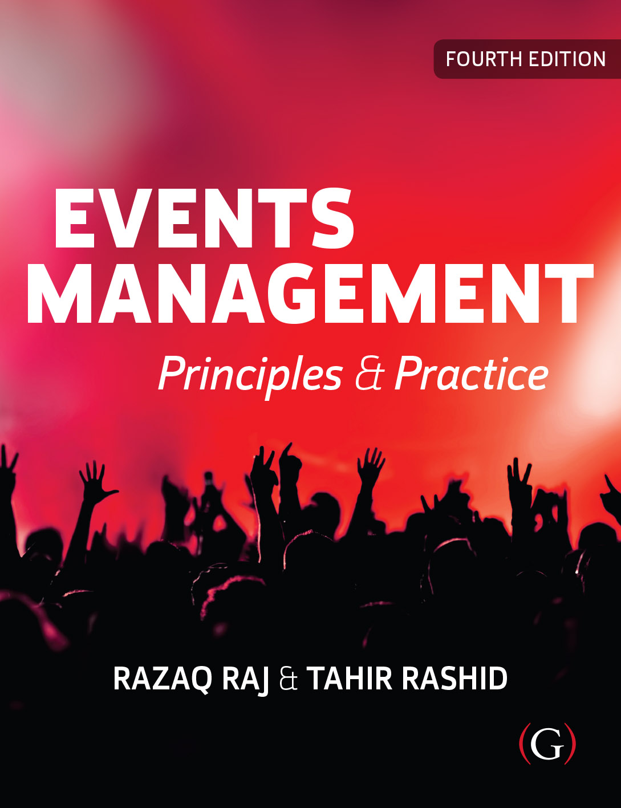
Events Management: Principles & Practice, 4th Edition
By Razaq Raj and Tahir Rashid

Slide 2
Chapter 8
Risk Management and Safety
Overview of Risk Assessment Process
Risk Factors for Events and Festivals
Event Risk Assessment Matrix
Health and Safety

Slide 3
Risk Assessment is developed to protect:
employees
visitors
volunteers
general public

Slide 4
Overview of Risk Assessment Process
What could go wrong
Identify the implications of each risk
Developing a suitable control measures to prevent loss
Damage or injury at the event and festival
Determine who is affected
Evaluation to control acceptable risks

Slide 5
Risk factors for events and festivals
Adopt international standards
COVID-19 global pandemic has changed the working conditions and organising sporting, musical, cultural and community events and festivals.
Risk management plan

Slide 6
Event risk assessment matrix
Severity scale
1 = trivial injury
2 = moderate injury
3 = moderate injury requiring hospital treatment
4 = serious injury or death
5 = multiple deaths/serious injuries
Likelihood scale
1 = very unlikely to occur
2 = unlikely, but possible
3 = might happen sometime
4 = probably will happen
5 = certainly will happen

Slide 7
Risk assessment plan should ask following questions.
What can harm to another person during before, during and after the event?
What can cause severe damage to equipment, event/festival site and Temporary and permeant structure?
What can harm the event reputation for future and negative marketing image for attendees?

Slide 8
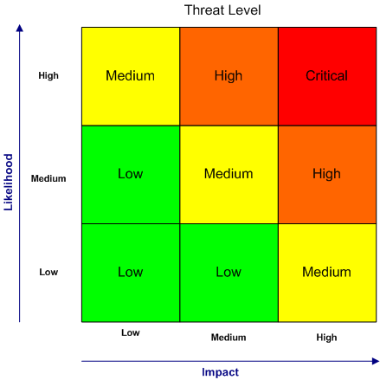
Risk Assessment Threat Level

Slide 9
Level Risks
Level of Risk | Type of risk
Lowest risk | No public gathering, only Virtual-only activities, events, conferences, concerts and festivals
Medium risk | Smaller weddings, indoor and outdoor events and festivals with attendees and in-person gatherings in which individuals from different households remain spaced at least 6 feet apart, wear masks, do not share objects, and come from the same local area (e.g., community, town, city, or county).
Higher risk | Medium-sized in-person gatherings that are adapted to allow individuals to remain spaced at least 6 feet apart and with attendees coming from outside the local area.
Highest risk | Large in-person gatherings where it is difficult for individuals to remain spaced at least 6 feet apart and attendees travel from outside the local area.
Centers for Disease Control and Prevention guideline for Events and Gatherings during Covid 19: Readiness and Planning Tool (2020)

Slide 10
Health and Safety Guidelines (HSG)
• Health and Safety Policy
• Organising
• Audit Planning and Implementing
• Measuring Performance
• Reviewing Performance

Slide 11
Health and Safety Guidelines (HSG)
Health and Safety Policy
Organising
Audit Planning and Implementing
Measuring Performance
Reviewing Performance

Slide 12
Risk 7 Step Process
Risk - 7 Step Process
Identify the hazards associated with the event
Identify the groups at risk and reasons why?
Assess the levels of risk – severity and probability.
Identify precautions and control measures to mitigate risks
Assess the levels of risk – severity and probability
Record and communicate
Evaluate after

Slide 13
World Health Organization (WHO) has outlined following COVID-19 guidelines.
Event organizers should establish direct links with local and national public health authorities.
There should be a nominated liaison person in the organizing team and also one in the designated public health agency. Contact information should be shared, and contacts should be available 24 hours a day.
Regular contact should be maintained throughout the planning period to share information, risk assessments, and plans.
Channels of communication between agencies and organizers and with the public should be agreed in advance.

Slide 14
Summary
Importance of risk assessment and safety regulatory requirements
keep up to date with the risk assessment changes in legislation and regulations
COVID-19 global pandemic has changed the working conditions for organising sporting, musical, cultural and community events and festivals.
Key strategy is to minimise a risk and put measures in place that reduces the risk.
Construct a risk assessment plan

Slide 15
Further Reading
Ahmed, Q. A. and Memish, Z. A. (2020) The cancellation of mass gatherings (MGs)? Decision making in the time of COVID-19 Journal of Travel Medicine and Infectious Disease, https://doi.org/10.1016/j.tmaid.2020.101631
Raj, R. Korstanje, M. and Griffin, K. (2018) Risk and Safety Challenges for Religious Tourism and Events. CABI Publishing, Wallingford.
World Health Organization (WHO) (2020) Key Planning Recommendations for Mass Gatherings in the context of COVID-19. https://www.who.int/publications-detail/key-planning-recommendations-for-mass-gatherings-in-the-context-of-the-current-covid-19-outbreak. (accessed 29/9/2020)

